Slide 1
redis

Slide 2
About
Redis is an open-source, in-memory data structure store that can be used as a cache, message broker, or a persistent key-value database. In this session, we’ll explore how to integrate Redis with a Golang application, leveraging the power of Redis for efficient data storage and retrieval.

Slide 3

Where is Redis used?

Slide 4
Where is Redis used?
Redis can be used in a lot of applications that we use in our everyday life. Redis helps to store and retrieve data in memory very easily and efficiently. Some of the use cases of Redis are:
Caching
Messaging and Queue
Session Store
Machine Learning
Real-Time Analytics

Slide 5
Caching: Redis is perfect for implementing a high in-memory cache to decrease data access latency and increase throughput. They can respond in milliseconds which makes it pretty fast and it also enables you to easily scale for higher loads without spending a huge amount of money for just the backend. Database query results caching, persistent session caching, web page caching, and caching of frequently used objects such as images, files, and metadata are all popular examples of caching with Redis.
Messaging and Queue: Redis also supports Pub/Sub (Publish and Subscribe) with pattern matching and a variety of data structures. This enables Redis to support high-performance messaging, chat rooms, and server intercommunication. We have used a lightweight queue using the Redis List data structure. Lists are ideal for a variety of applications that needs a reliable message broker as it offers atomic operations as well as blocking capabilities.

Slide 6
Session Store: For internet-scale applications, Redis is the best choice as it supports in-memory. It provides sub-millisecond latency, scale, and resiliency required to manage session data like session state, credentials, and more.
Machine Learning: As we know, Machine Learning models can be a slow and time-consuming process to load some data as inputs and process it to produce outputs. This process can be handled by Redis and the application performance can be increased significantly. With this, many machine learning models can be deployed in production and have a smooth functionality with users.
Real-Time Analytics: As Redis handles data with sub-millisecond latency, it is the perfect choice for real-time analytics like social media analytics, ad targeting, personalization, Artificial Intelligence-based applications, Cyber Security, and more.

Slide 7
Merits of using Redis

Slide 8
Redis is great for delivering results faster and managing data that is to store and retrieve it. Some merits of Redis are:
Faster Database responses: They store data in RAM, rather than on an HDD (Hard Disk Drive) or SSD (Solid State Drive).
Has Control over Lifetime of a Data: Redis supports the Time to Live (TTL) feature where if the keys are set in TTL mode with the duration time to live, data will expire after this time elapses.
Key-Based Access: Redis is based on a key-value model. Key-Based access allows for extremely efficient access times. We can access the data using Redis GET and SET semantics. They are very fast though, they can perform around 110, 000 SETs per second and around 81, 000 GETs per second.
Language Support: Redis is supported by most of the programming languages like Python, C, C++, Java, JavaScript, and more.

Slide 9
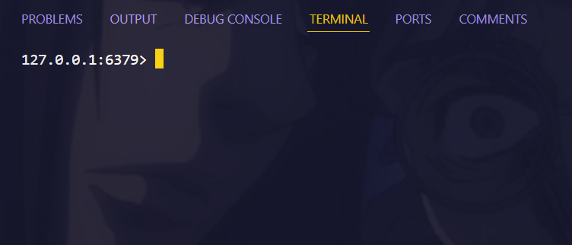
implementation
After installation run redis-cli in your terminal you will get something like this

Slide 10
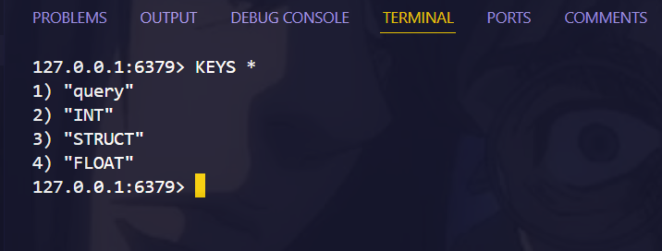
implementation
The output of the KEYS * command shows the keys currently stored in your Redis database

Slide 11
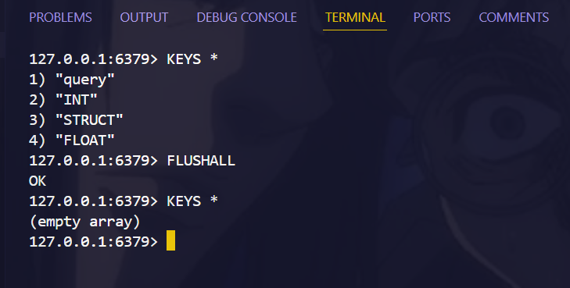
implementation
Use FLUSHALL to Remove all the data

Slide 12

implementation
SET in Redis: It sets a value to a key as shown below (used to store data).

Slide 13
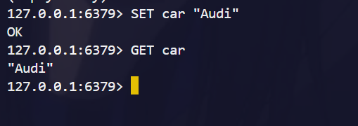
implementation
GET in Redis: It gets the value using the key as shown below (used to retrieve data).

Slide 14
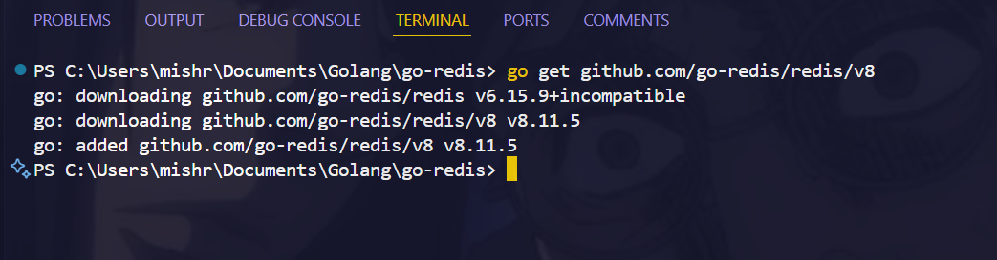
Connecting Redis with golang
To connect Redis with Golang, you can use a Redis client library. One of the most popular and widely used libraries is go-redis

Slide 15
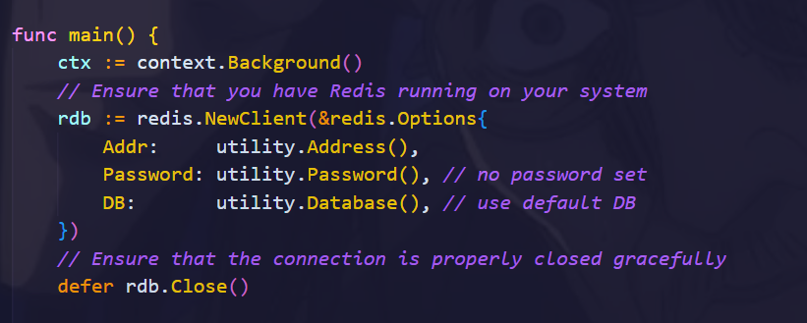
Connecting Redis with golang
To connect Redis with Golang, you can use a Redis client library. One of the most popular and widely used libraries is go-redis

Slide 16
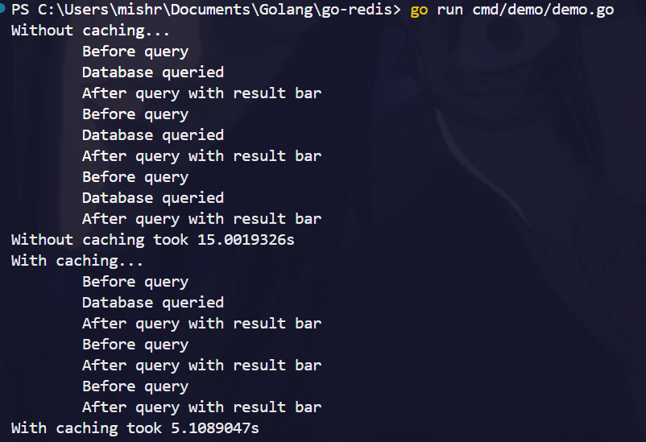
https://www.loom.com/share/a6ec1496e4f14bf99b39bcec5b1cc8f1?sid=f0c51beb-55c7-4f29-bafa-0ca81d66d6ca#

Slide 17

Thank you

